Slide 1
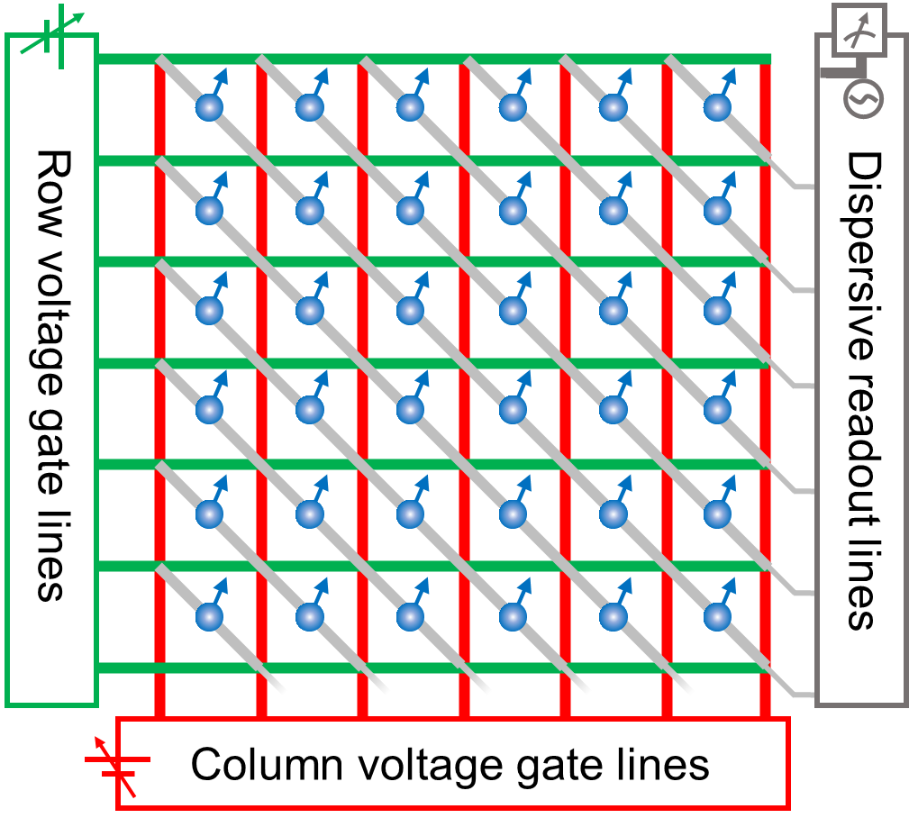
Electric field control of single spins in oxide ferroelectrics
Spin axis
Polar axis
Nima Leclerc^{1,2,3} , Katherine Inzani^{2,3}, Nabaraj Pokhrel⁴, Elizabeth Nowadnick⁴ and Sinéad Griffin^{2,3}
APS March Meeting 2021
¹ School of Engineering and Applied Science, University of Pennsylvania, Philadelphia, PA
²Materials Sciences Division, LBNL, Berkeley, CA
³Molecular Foundry, LBNL, Berkeley, CA
⁴ Department of Materials Science and Engineering, UC Merced, Merced, CA
nleclerc@seas.upenn.edu
March 17, 2021

Slide 2
Electrostatic control of spins: past and present
Room temperature electrostatic switching of magnetisms in BiFeO₃
(2014)¹ [governed by DMI]
Electrostatic control of spins realized in non-volatile memory devices by Intel (2019)²
Coherent electrostatic control of Fe spins in PbTiO₃ [governed by SOC + CF]
(2021)³
¹Nature 18 Dec 2014: Vol. 516, pp. 370-373
²Nature 3 Jan 2019: Vol. 565, pp. 35-42
³Science Advances 03 Mar 2021: Vol. 7, no. 10, eabf8103
Notes:
Electric field control of ferromagnetism in BiFeO3 due to multiferroic order at RT. MF arises from DMI interactions [exchange]. First demonstration of reversal via E-field, resulting in switching. (note: multiferroics have been around since early 2000s)
Device applications: MESO devices from Intel,
We can also place magnetic ions in a ferroelectric and control with an electric field, using electrostatic and magnetic pulse sequences used in the NV-center in diamond qubit community. Here’s a result from a recent paper in our group in collaboration with experimental groups in Prague, Oxford, and UC Berkeley. Where the systems were placed in the persoskvite PTO.

Slide 3
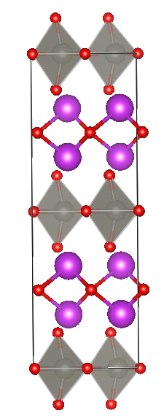
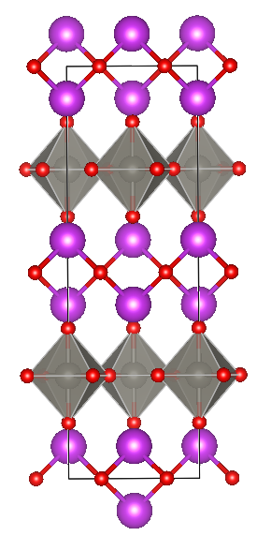
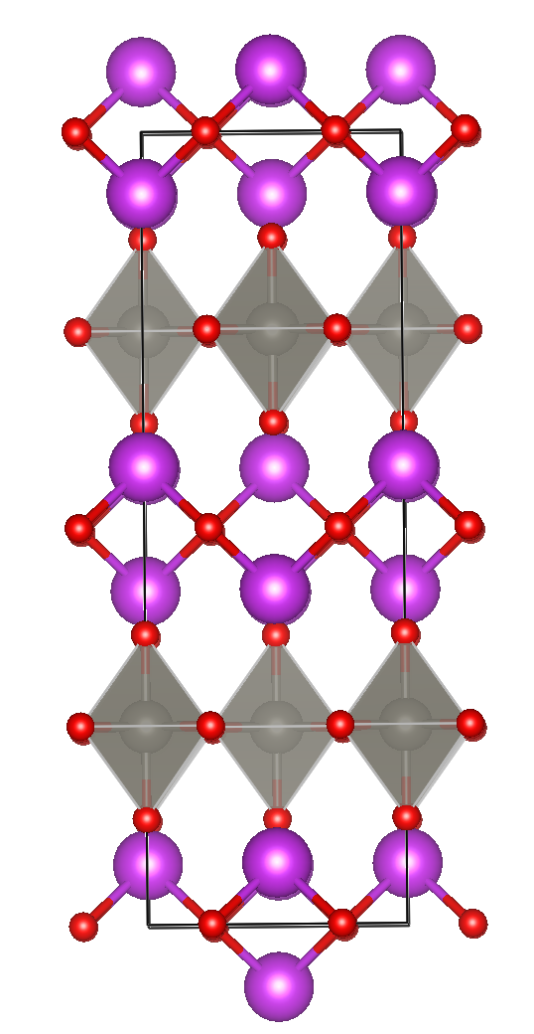
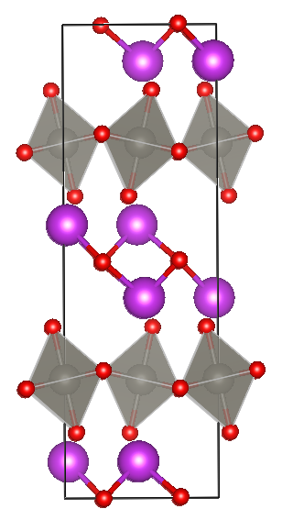
Bi₂WO₆ as a ferroelectric host
O2
O1
O3
Bi
W
z
Undistorted
structure
GM₅⁻
X₂ ⁺
X₃ ⁺
x
Notes:
- Note: explain each distortion
Start with undistorted BWO structure (parelectric). BWO is among the Aurvalious phases ➔ large composition and low-symmetry phase space to explore. Layered structure: Bi layers with stacked of distorted W octahedra.
P_r = 14.2 μC/cm² (BiFeO3 has 150 μC/cm² ). Orthorhombic crystal structure in ferroelectric phase w/ P21ab space group. Gamma_5 – mode will distort the W octahedra (this mode is responsible for polarization) along the x axis (a axis in this figure).
X_2 mode will not do anything
X_3 mode will further distort the O-atoms in W octahedra and Bi atoms.
These are the phonon modes we care about in switching ➔ gives rise to multiple ferroelectric switching paths (1 step and 2 step). We will only assume a 1-step switching path.

Slide 4
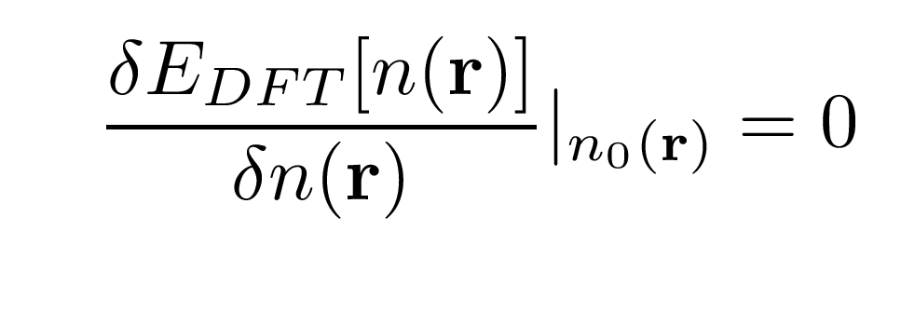
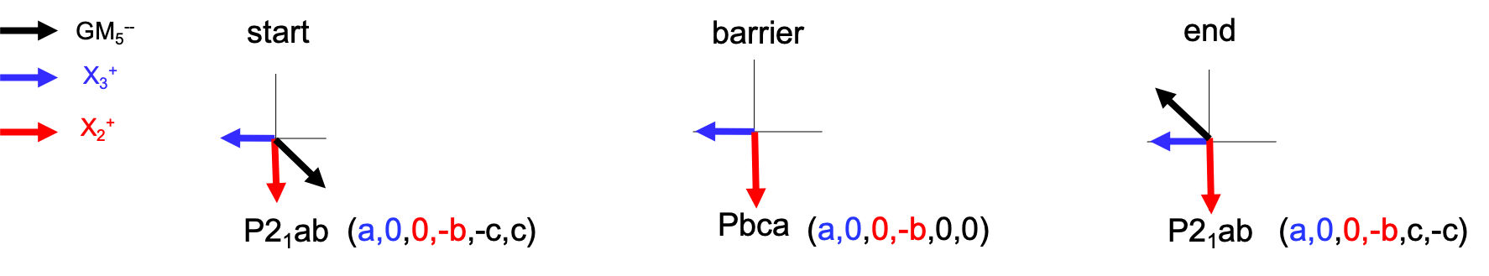
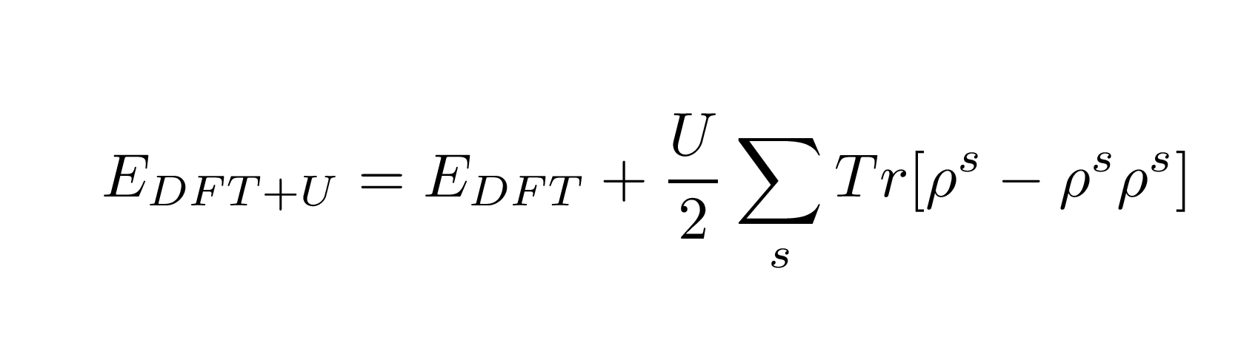
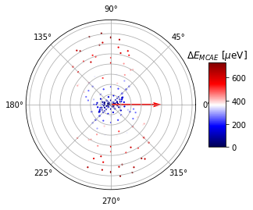
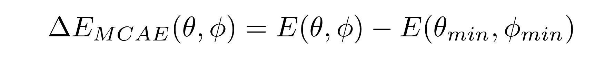
Our approach: predict potential spin switching pathways
Ferroelectric switching pathway predictions
Magnetic property predictions
Solve for paraelectric structure
4. Solve for relaxed Fe doped structures
Substitute Fe ion in 2x2x1 supercell for each stable + metastable phase ➔ relax structure
Generalized gradient approximation (GGA) within density functional theory (DFT)
5. Spin collinear + non-collinear calculations
Compute total energies of for collinear and non-collinear spin configurations. Use Hubbard-U correction and spin-orbit coupling
2. Find lattice distortions in phase space
Map distortions to 2 domains corresponding to 2 energy minima: +/- P (start and end)
6. Obtain MCAE + easy axis
3. Use nudge elastic band to find intermediates
Calculate energy for multiple spin
directions ➔ easy axis corresponds
to lowest energy. Perform fit.
Predicts most energetically favorable combo of distortions ➔ correspond to metastable phases
Notes:
Break up into two steps between us on our collaborators at Merced: ferroelectric switching predictiions and MCAE predictions.
First, our collaborators found the relaxed paralectric BWO phase
To find ferroelectric phases and intermediate phases, they introduced phonon distortion (in different combonations). To find thestable ferroelectric phase, they found 2 domains corresponding to 2 energy minima. These are the + and – polarization states . Done in phase space ==> these were mapped to real space
Finally, to find the intermedait phases, they looked at combonations of distortion modes and computed the most energetically favorable modes via nudge elastic band. From this, determined the metastable phsaes
The second step was done on the Berkeley side. For each metstalbe phase, substituted Fe on different sites and found the ground state through structural relaxation
For magnetic calcualitons, perform separate collinear and non-collinear calculations w/ SOC and Hubbard correction ..

Slide 5
Fe³⁺ can sit on Bi or W sites in the Bi₂WO₆ host
Bi site 1
W site
z
Bi site 2
P2₁ab
P2₁ab
x (polar)
Notes:
Note: Bi site 2 is wrong
Fe can sit on 3 possible sites in the ferroelectric BWO structure. There are two symmetrically inequivilant Bi sites and 1 symmetrically ineq. W site
Bi site 1: distorted trigonal pyramamidal structure.
Bi site 2
W site: distorted octahedral structure
We will only consider Bi site 1 and W structure in our calculations ➔ interested in how the spin easy axis rotates wrt. that site. These low-symmetry crystal fields give rise to magnetic anisotropy.

Slide 6
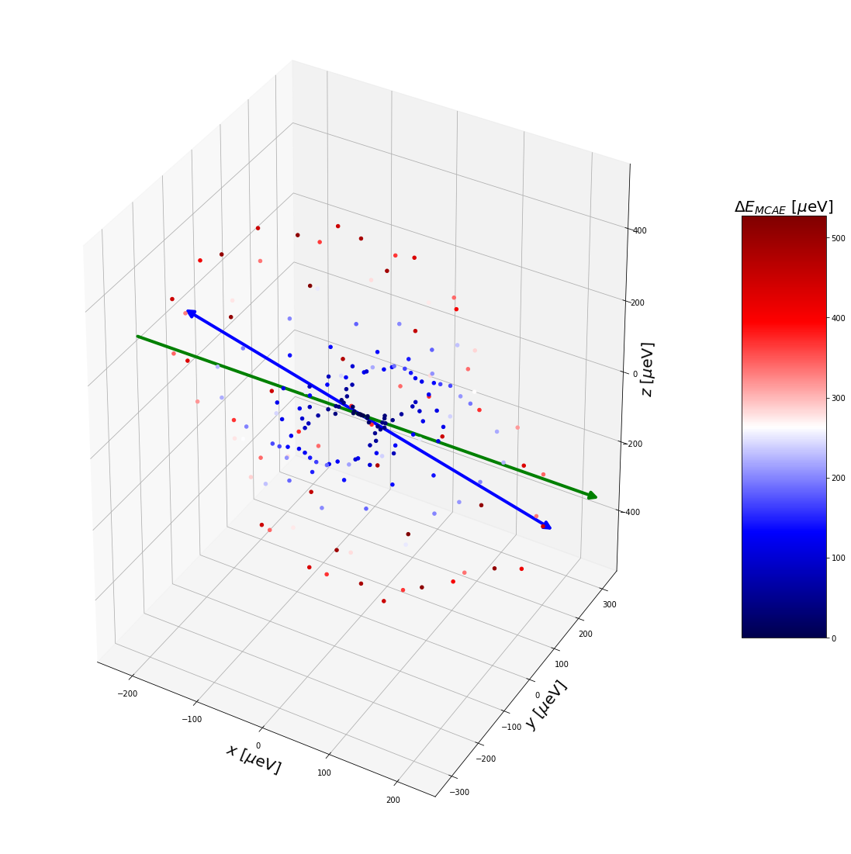
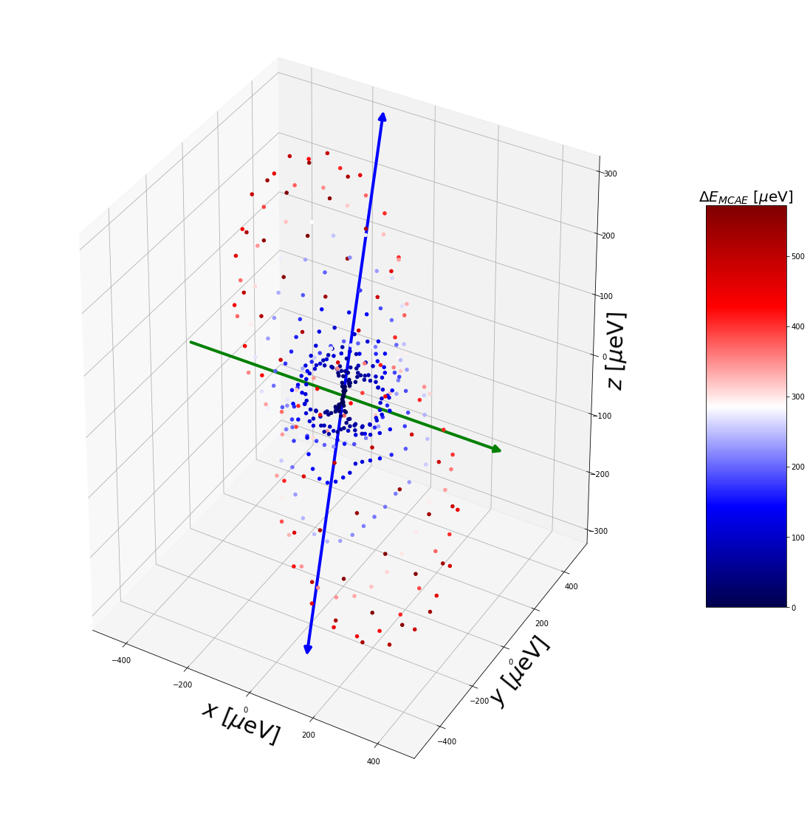
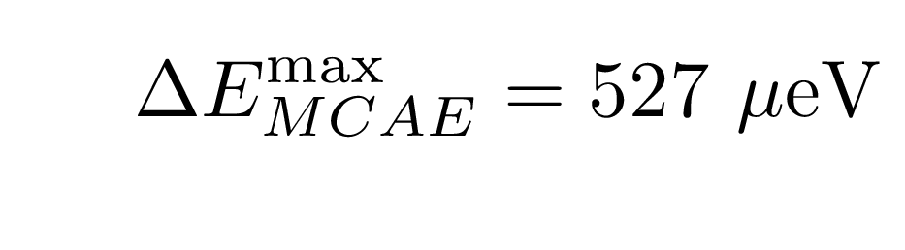
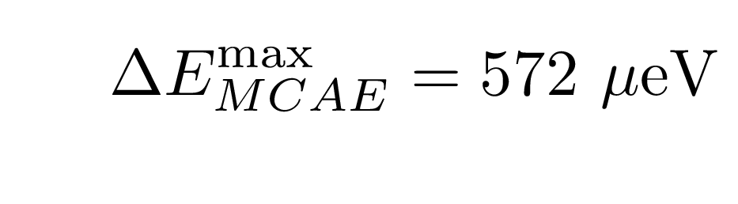
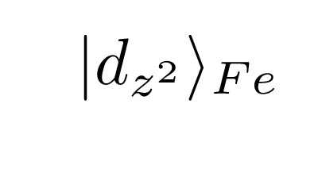
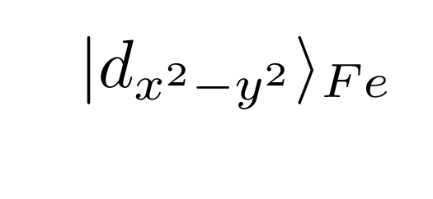
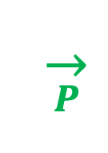
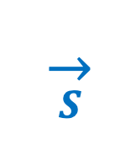
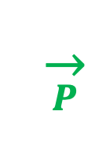
Magnetic anisotropy predictions for P2₁ab [stable phase]
Fe³⁺ on Bi
Fe³⁺ on W
Spin axis
Spin axis
Polar axis
Polar axis
$$\overset{→}{S}$$
$$\overset{→}{P}$$
$$\overset{→}{P}$$
$$\overset{→}{S}$$
Notes:
Note. A nice result for this is that measuring the spin axis should allow us to determine which site the Fe dopes onto. Crystal structure insets need axis labels. Consider orbital plots instead.
Bi site: ~ trigonal pyramidal site. Easy axis and polarization vector ~ perpendicular
W site: ~tetragonal crystal field. Easy axis and polarization ~ parallel.
Compare this to the PTO structure which has an easy plane due to 4 fold symmetry ➔ easy axis now present due to crystal field distortions. We suscept that the d orbitals of the Fe ion are distorted in a way that is perpendicular to the x-y plane for the Bi site. Hence, the spin will rotate to align with the Fe d-orbitals, which will maximize SOC and minimize its energy. The d orbitals are lying in plane due to crystal field distortion.

Slide 7
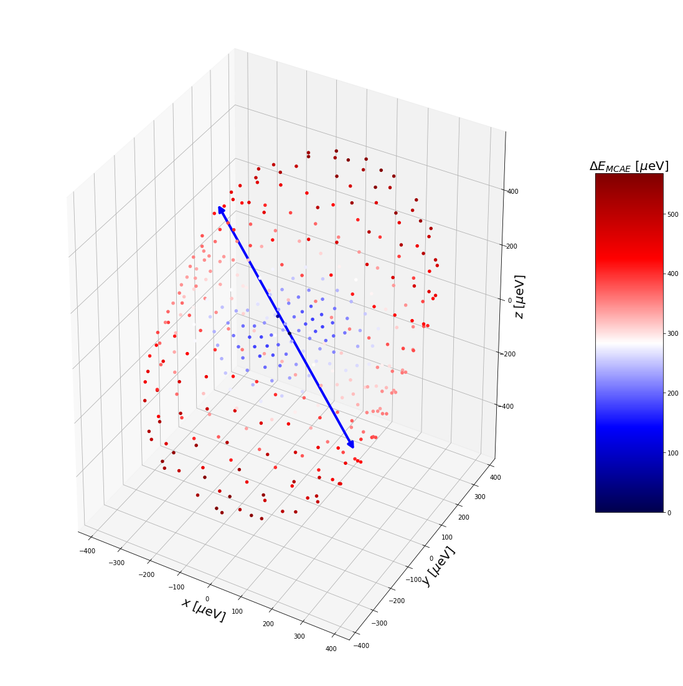
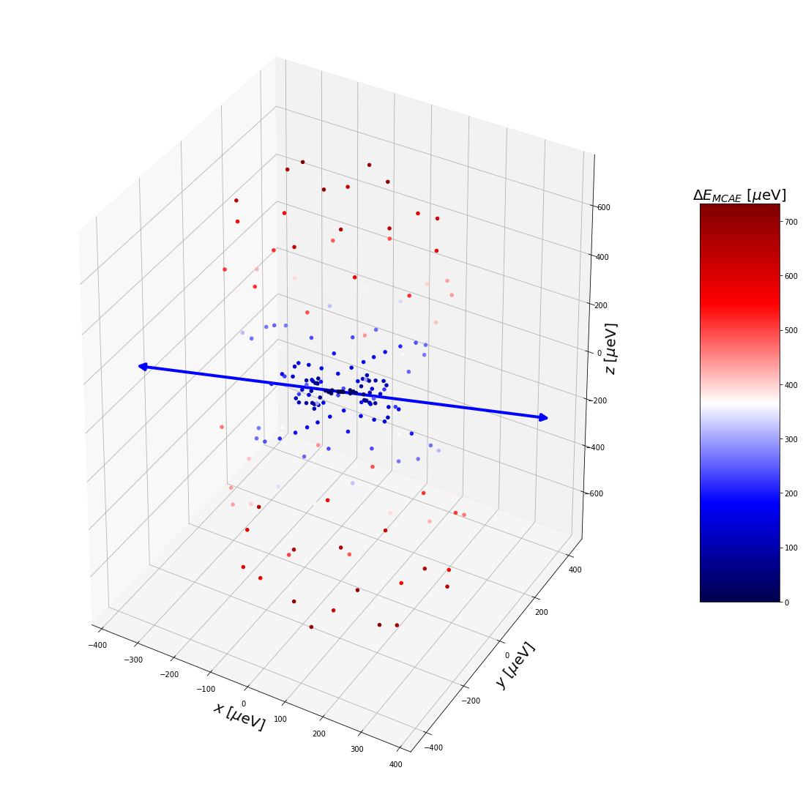
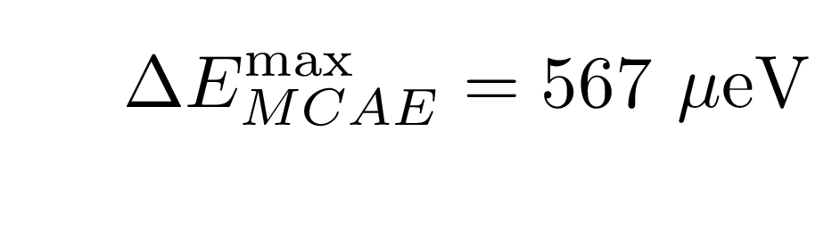
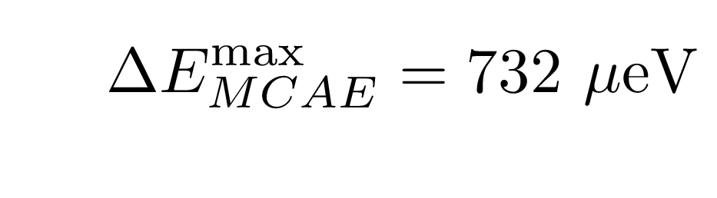
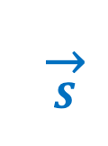
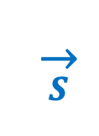
Magnetic anisotropy predictions for Pbca [barrier phase]
Fe³⁺ on Bi
Fe³⁺ on W
Spin axis
Spin axis
$$\overset{→}{S}$$
$$\overset{→}{S}$$
Notes:
Notes: 3D plots. Arrows -> axis. Crystal structure insets need axis labels. Consider orbital plots instead.
For the barrier phase, the local environment/crystal field is quite similar to P21ab. This time, the polarization is turned off and we’re assuming this structure is non-polar.

Slide 8
Polarization switching leads to spin switching: Fe³⁺ on Bi site
Spin axis
Polar axis
z
x
Notes:
In the top, we see the 1 step ferroelectric transition which is mediated by an external field and in the bottom we have the corresponding spin rotation.

Slide 9
Polarization switching leads to spin switching: Fe³⁺ on W site
*
Spin axis
Polar vector
z
x
Notes:
For W, the spin axis and the polar axis are always parallel? What happens in the intermediate?

Slide 10




Conclusions and acknowledgments
Spin-orbit coupling and distorted crystal field directly impacts the presence of a spin easy axis
Ferroelectric Aurivillius phases have a rich compositional and low-symmetry phase space to explore new host materials
Spin axis perpendicular to polarization for Fe on Bi site and parallel for Fe on W site
Ongoing work: look at multi-step switching pathways, EPR measurements
Big thanks to Sinéad Griffin, Katherine Inzani,
Elizabeth Nowadnick, and Nabaraj Pokhrel!
Related Talks:
Abstract: P29.00014 : Optimizing magnetic dopants in ferroelectrics for defect-based qubits [Katherine Inzani]
Abstract: L53.00004 : Electric field control of spins in piezoelectrics, ferroelectrics, molecules, and on surfaces [Arzhang Ardavan]
*Supported by the Department of Energy Contract No. DE-AC02-05CH11231.

